Slide 1
Employee Training Management
Training management application for BM India employees.

Slide 2
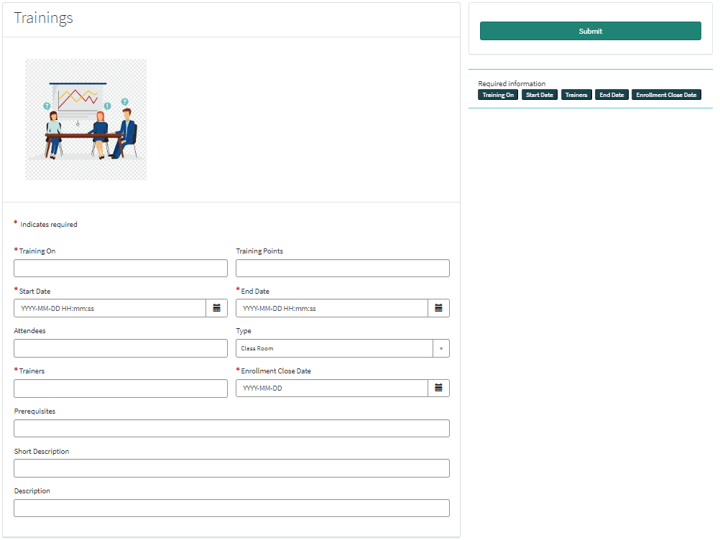
Record Producer for Creating a Training Record

Slide 3
The members of the “Trainers” group can submit this Record Producer on the portal to generate a new Training record.
This record producer will only be available to the members of the “Trainers” group.
The person has to specify some mandatory fields like ( Training On, Start Date, End Date, Enrollment Close Date) in order to submit the record.

Slide 4
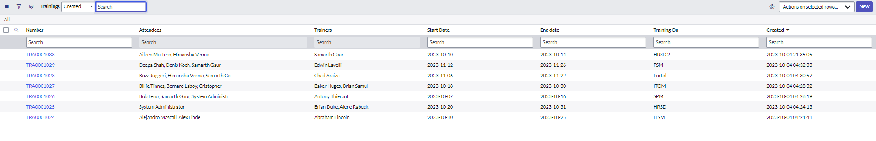
Trainings Table (u_training)
Records being created on the training table.

Slide 5
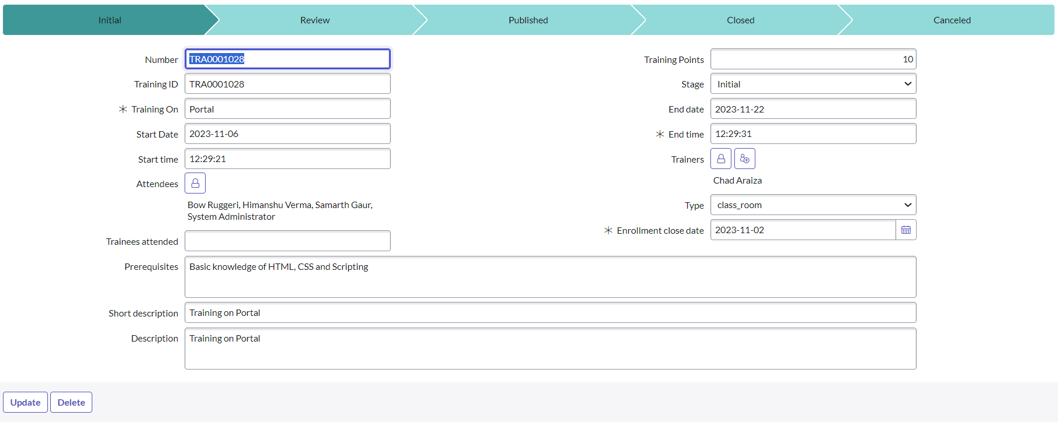
Training Form

Slide 6
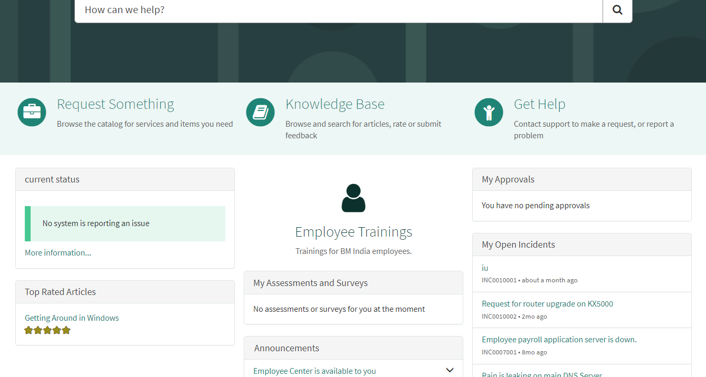
Link Icon for Employee Trainings

Slide 7
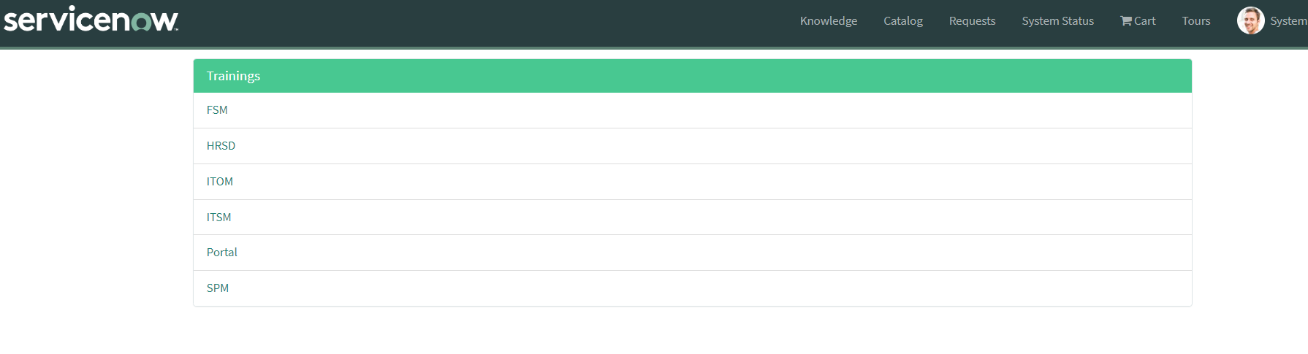
There is an icon on the Service Portal through which the employees can enroll in any of the trainings of their choice.
This icon is available to every employee, including the members of the “Trainers” group.
A list of records will be visible to the employees of available trainings.

Slide 8
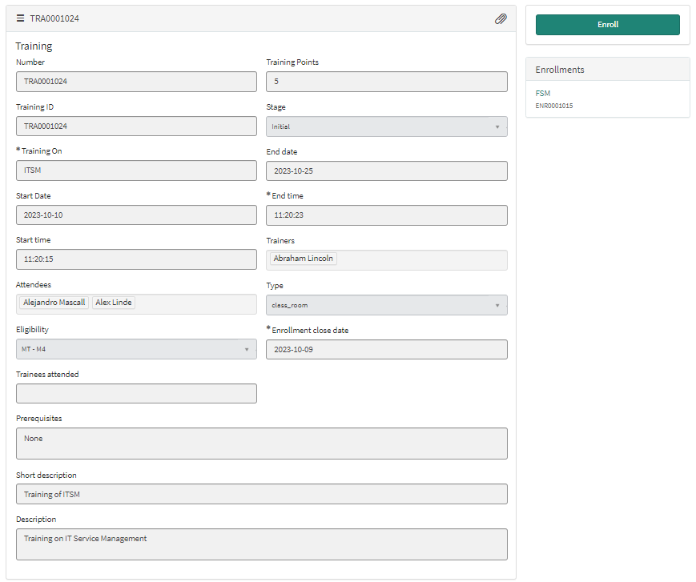
An “Enrollments” widget has been provided to the employee so that they know in which of the trainings they have enrolled.
A read only form is displayed to the employee to provide them with all the information of that particular training.

Slide 9
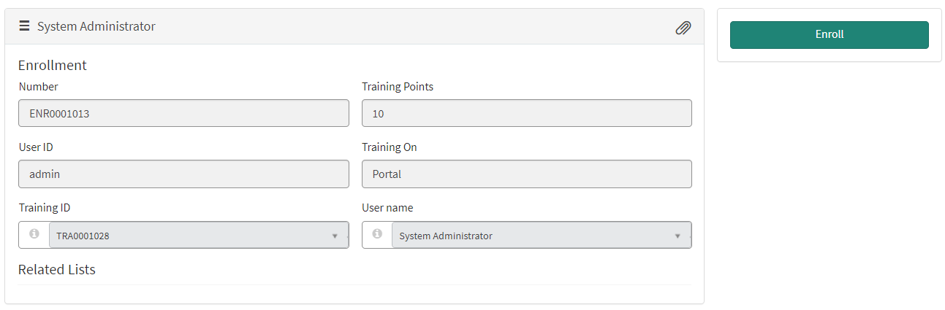
The users can see the read only Form displaying the record of their Enrollment.

Slide 10
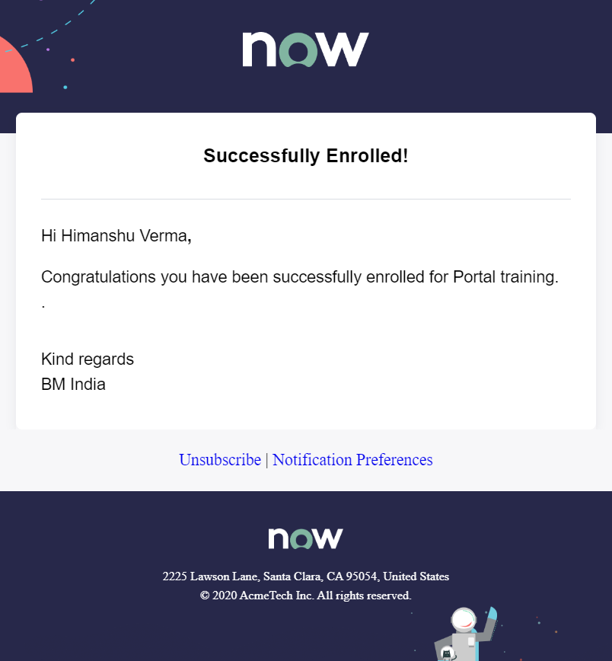
An email is sent to the employee after his/her successful enrolment in the training.

Slide 11
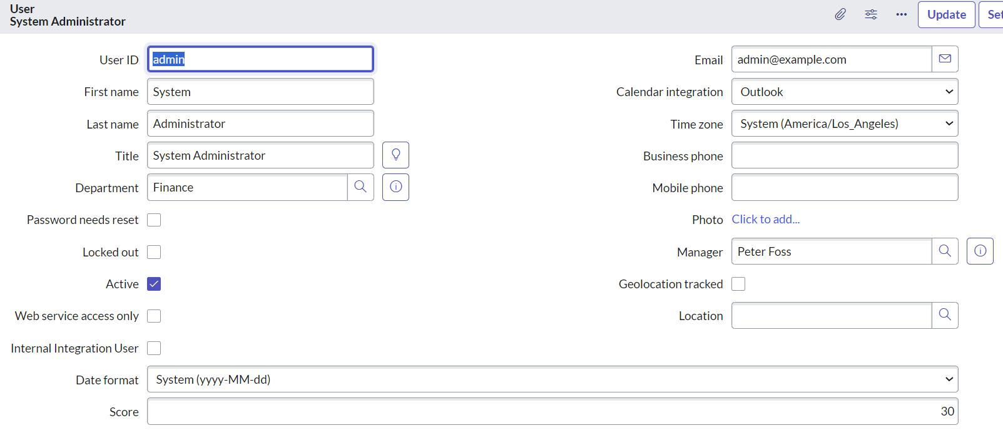
Whenever a training gets closed, its training points are added to the scores of all the people that attended that training.

Slide 12
THANK YOU

